Slide 1

Analysis Report
Computer Science Department Building
University of Mines and Technology (UMaT)
ENTERPRISE &
PERIMETER
SECURITY
Course
Enterprise & Perimeter Security
Team
9-Member Security Analysis Group
Date
March 2025
CONFIDENTIAL; FOR ACADEMIC USE ONLY

Slide 2






Presentation Overview
20 slides across 6 security domains
Physical Perimeter
Access Control
Surveillance
Slides 3–4
Slides 5–6
Slides 7–8
Wireless Security
Human Factors
Network Architecture
Slides 9–14
Slides 15–16
Slides 17–20
Enterprise & Perimeter Security Analysis | UMaT ACSES Department

Slide 3
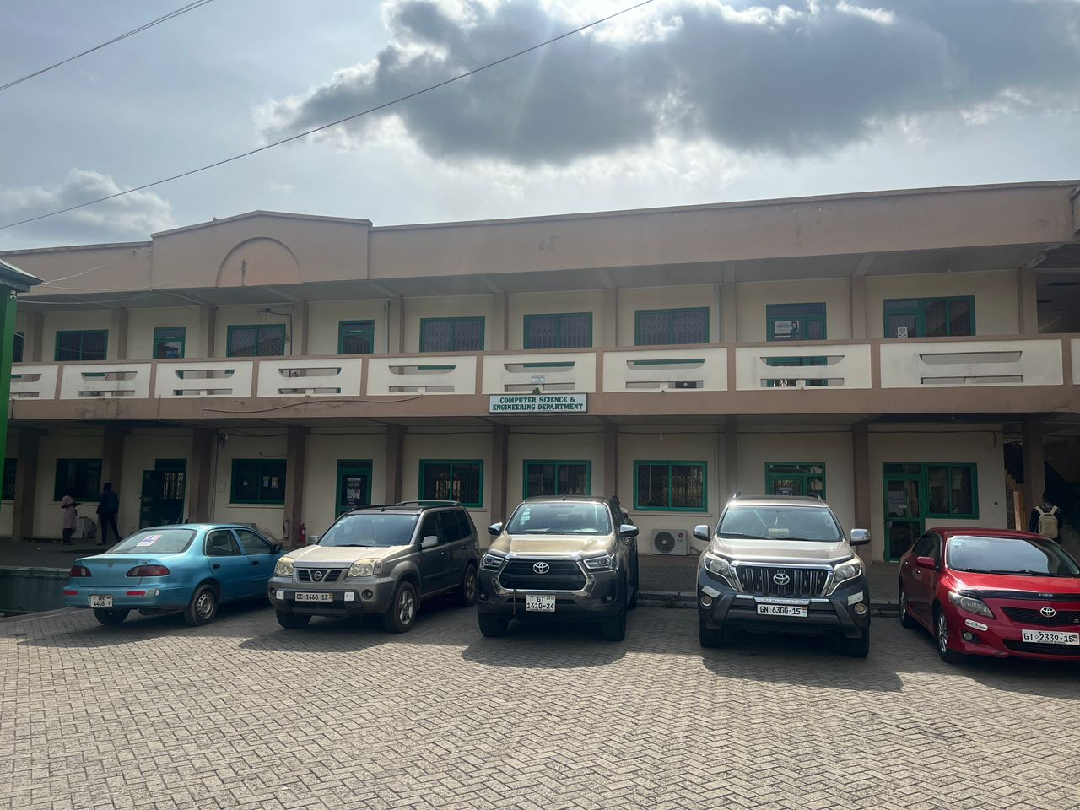
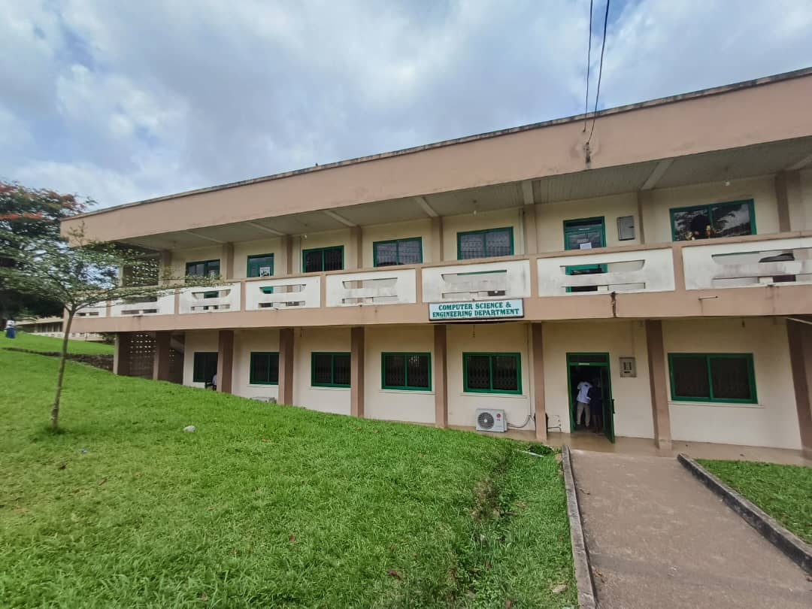
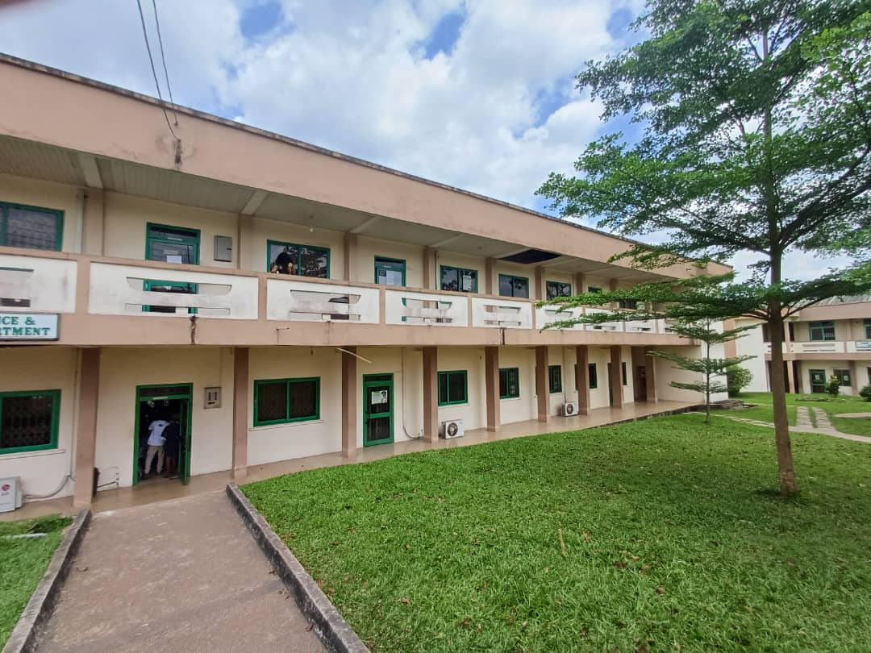
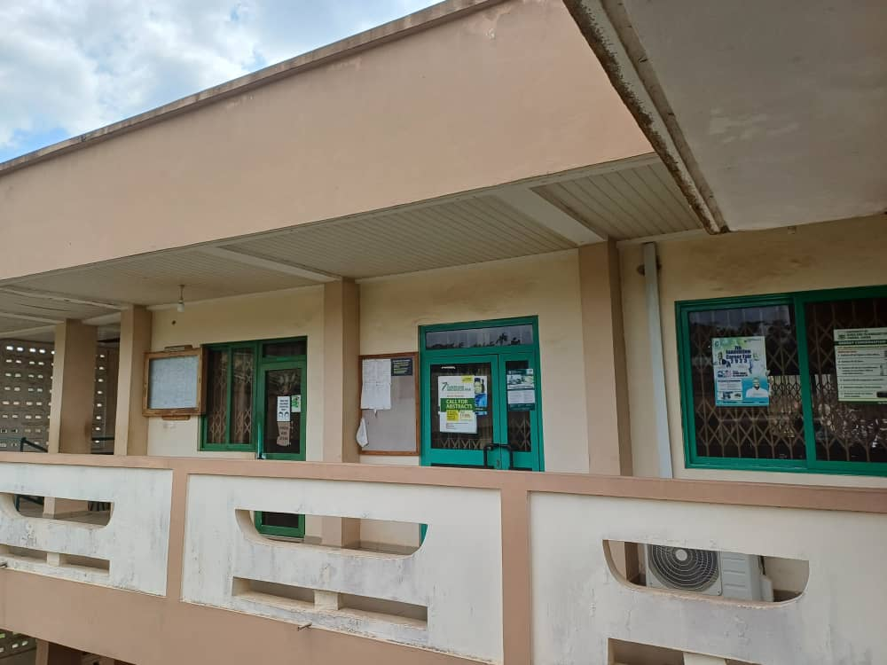
PHYSICAL PERIMETER; BUILDING LAYOUT
ACSES Department Building; Site Survey
SECURITY ZONE CLASSIFICATION
PUBLIC ZONE
Main entrance, hallways
Open to all; monitor only
Front facade (car park view)
Side angle; Computer Sci. & Eng. Dept. sign
CONTROLLED ZONE
Labs, offices, IT support
Authorised staff & students
RESTRICTED ZONE
Server room, core network
IT personnel only
Rear approach & stairwell access
First-floor corridor & balcony
Enterprise & Perimeter Security Analysis | UMaT ACSES Department

Slide 4
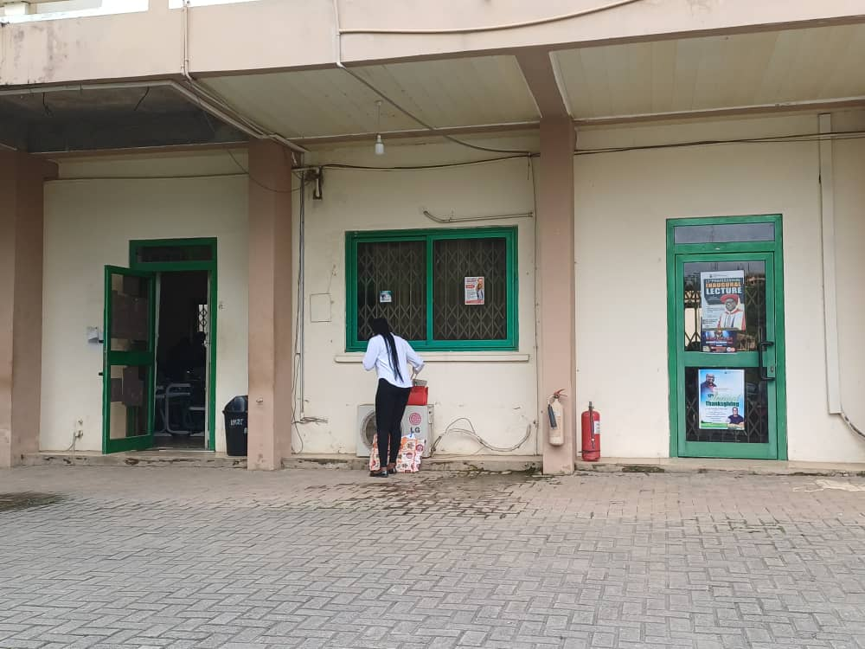
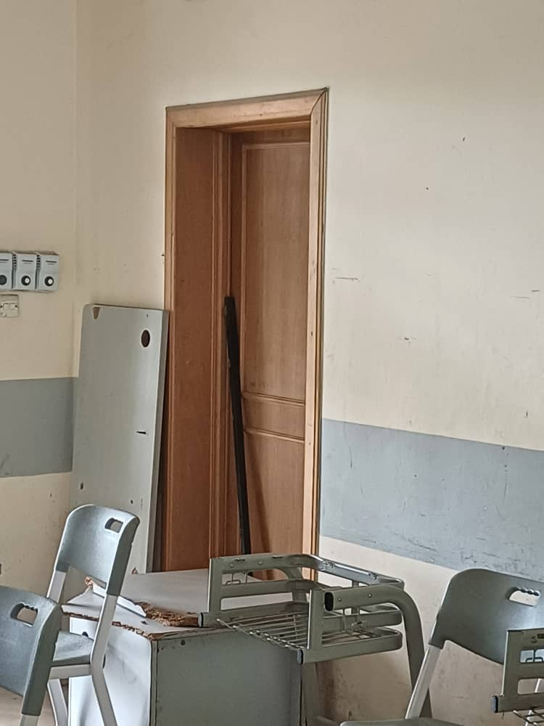
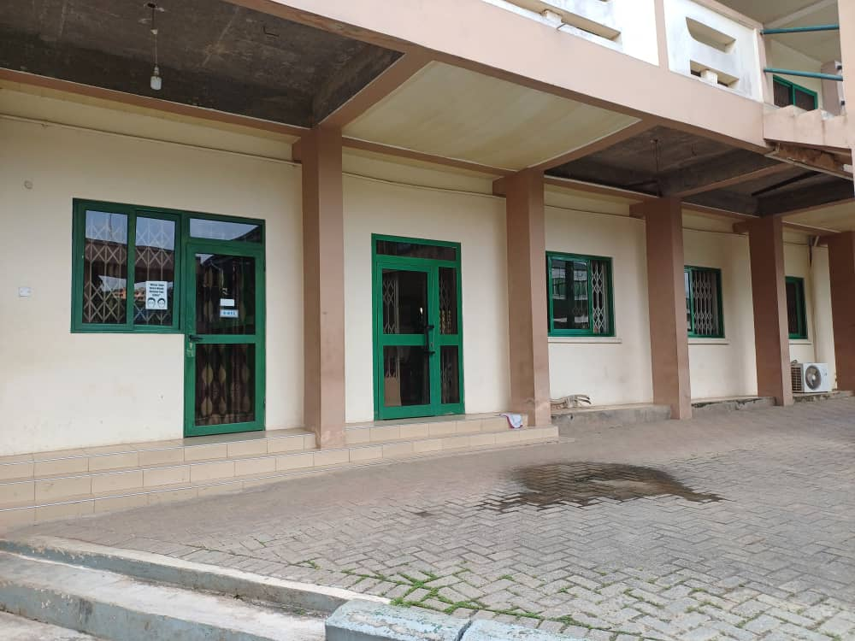

PHYSICAL PERIMETER; ENTRY POINTS
High-Risk Entry Points; Site Photographs
Ground floor; open unmonitored entrance doors
Interior lab-to-office connecting door (no camera to see who enters and leave)
Ground floor windows & doors; no biometric security locking
CRITICAL
CRITICAL
HIGH
HIGH
CRITICAL
Main Entrance
CL1 Corner Doors (×4)
Lab-to-Office Door
Ground Floor Windows
Server Room
All entry points shown above operate without any electronic access control, keycard, biometric authentication, or audit trail. A standard door handle is the only barrier between an open corridor and the server room.
Enterprise & Perimeter Security Analysis | UMaT ACSES Department

Slide 5

ACCESS CONTROL; CURRENT STATE
No Access Control Infrastructure Exists
ZERO
formal security controls of any kind operate in this building today
No Security Guards
No CCTV Cameras
Anyone enters & roams unchallenged; no staffed front desk or patrol.
Zero electronic monitoring, deterrence, or forensic recording capability.
No Keycard Access
No Biometric Auth
Doors are the only barrier. Many remain unlocked during operational hours.
Server room has no authentication; only informal proximity to IT office.
No Visitor Registration
No Workstation Policies
No record of who enters or when. Contractors arrive completely unlogged.
No auto-lock policy. Unattended logged-in machines common in the lab.
Actual ground-floor doors; no keycard, no lock, no monitoring
Enterprise & Perimeter Security Analysis | UMaT ACSES Department

Slide 6

ACCESS CONTROL; PROPOSED SOLUTIONS
Zone-Appropriate Access Control Mechanisms
PUBLIC ZONE
Motion-activated lighting at all entrances
Directional signage for expected visitor flow
Single staffed front desk during operational hours
CONTROLLED ZONE
Keycard access on all lab & office corner doors
Electronic locks with full audit trail & time-based schedules
Staff supervision required whenever external visitors are present
Auto-lock policy on all lab workstations (5-min inactivity)
RESTRICTED ZONE
Biometric authentication (fingerprint + PIN) for server room
Physical access log for all entry events
Intrusion alarm linked directly to IT security personnel
Named-personnel access list; no generic IT credentials
Enterprise & Perimeter Security Analysis | UMaT ACSES Department

Slide 7
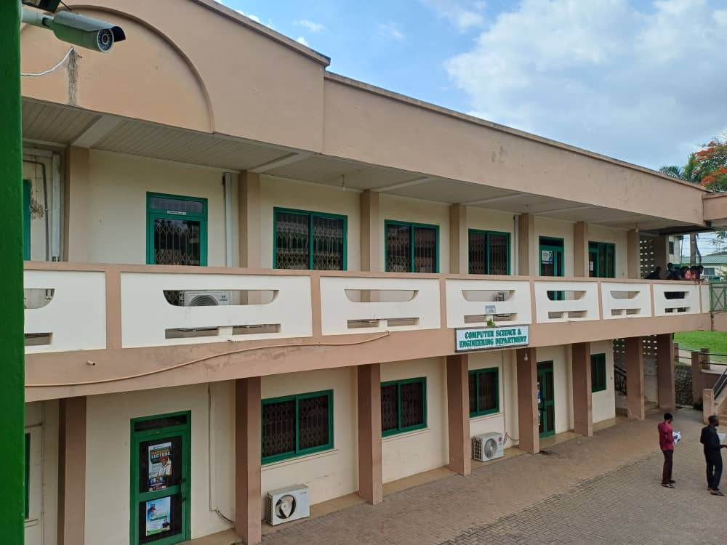
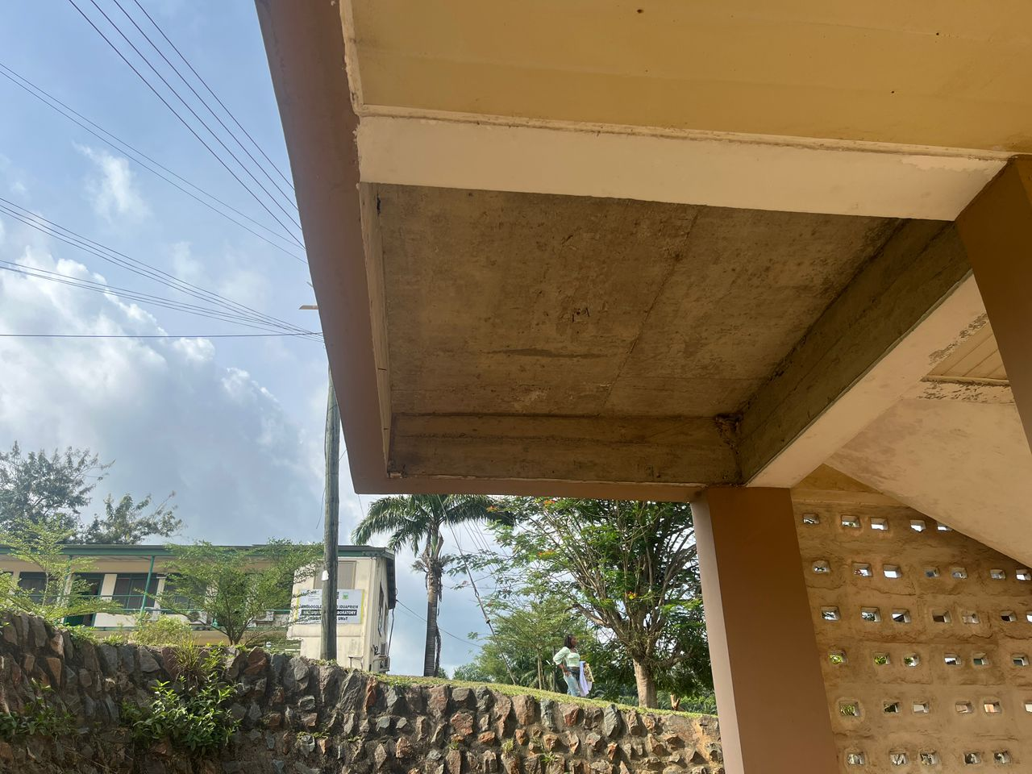
SURVEILLANCE & MONITORING; CCTV
16-Camera CCTV Infrastructure Proposal
CAMERA PLACEMENT STRATEGY
Main Building Entrance
2
Wide-angle; captures all arriving & departing individuals
CL1 Corner Doors (×4)
4
One per corner; single camera covers 2 doors simultaneously
Comp. Eng. Lab Doors
4
Priority: top-right Lab-to-Office Controlled/Restricted boundary
Note CCTV camera (top-left); adjacent building only. ACSES building has none.
Stairwells & Corridors
3
Between-floor movement tracking; off-hours access detection
Server Room Corridor
3
Dedicated Restricted Zone coverage with continuous recording
16 cameras · 8 per floor · 4 corner doors covered per room · 0 cameras currently deployed
Overhang & roof eaves; potential camera mounting points and blind spots
Enterprise & Perimeter Security Analysis | UMaT ACSES Department

Slide 8
SURVEILLANCE; LIGHTING ASSESSMENT
Critical Lighting Failure: A CCTV Prerequisite
8
9
47.2
/18
/18
%
Bulbs functional
Ground Floor
Bulbs functional
First Floor
Overall building
lighting efficiency
CCTV Cannot Operate Without Lighting
With only 8 of 18 bulbs functional on the ground floor, no camera can produce usable images. Lighting restoration is a prerequisite for any surveillance deployment; not an afterthought.
IMMEDIATE REMEDIATION
Replace all 10 non-functional bulbs on ground floor; 1 day task, negligible cost
Audit and replace 9 non-functional first-floor bulbs; coordinate with facilities
Install motion-activated emergency lighting at all stairwells and corridor junctions
Enterprise & Perimeter Security Analysis | UMaT ACSES Department

Slide 9
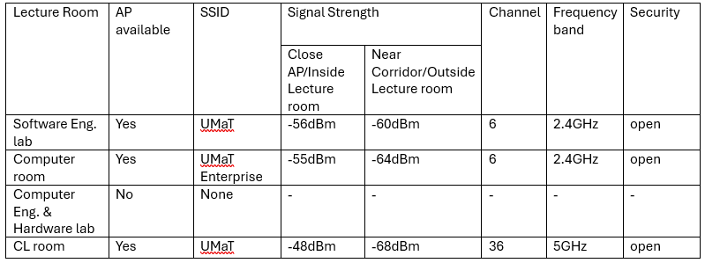
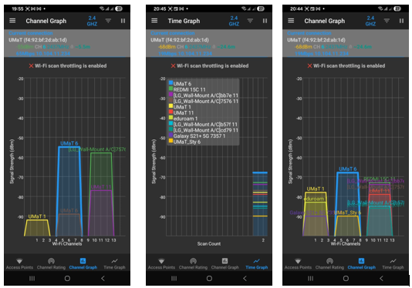
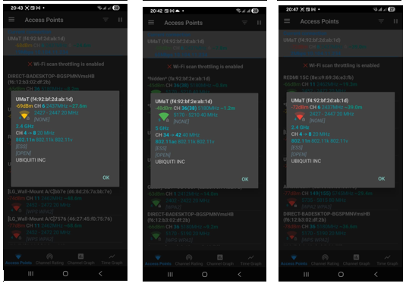
WIRELESS SECURITY; SURVEY FINDINGS
WiFi Analyzer Scan Results; Real Survey Data
SURVEY DATA TABLE (from actual WiFi Analyzer scan)
KEY FINDINGS
3
Open/unencrypted
networks detected
2
Hidden SSIDs
(both immediately detected by scanner)
WiFi ANALYZER; CHANNEL GRAPHS & ACCESS POINT DETAILS
1
Deprecated WPA v1
(TKIP; insecure since 2009)
0
Centralised management
or WIPS deployed
Signal at −62 dBm from car park; fully attackable from outside
Enterprise & Perimeter Security Analysis | UMaT ACSES Department

Slide 10


WIRELESS SECURITY; THREAT SCENARIOS
Exploitable Threats Enabled by Current Posture
CRITICAL
Evil Twin / Rogue AP Attack
Attacker in car park clones 'UMaT' SSID. Devices auto-associate. Attacker acts as man-in-the-middle; intercepting credentials, session tokens and transfers. No WIPS exists to detect this.
CRITICAL
Passive Traffic Sniffing
Three open networks transmit all data in plaintext. Any device in range; including from the car park; can use Wireshark to capture logins, emails, and files in real time with no active connection required.
HIGH
Hidden SSID Probing Attack
Devices hunting hidden SSIDs broadcast probe requests revealing real network names. Attacker captures these, learns the hidden SSID, then clones it with a higher-power AP.
HIGH
External Network Reconnaissance
At −62 dBm in the car park, attackers can enumerate all SSIDs, attempt PMKID capture for offline cracking, run deauth floods, and map the full topology without entering the building.
Enterprise & Perimeter Security Analysis | UMaT ACSES Department

Slide 11

WIRELESS ARCHITECTURE; AUTHENTICATION
WPA3 + 802.1X / RADIUS + NAC
WPA3-Enterprise (Staff SSID)
RADIUS & NAC FLOW
1
Device connects to staff SSID → 802.1X exchange initiated
Each user authenticates individually via 802.1X PEAP-MSCHAPv2. Per-session encryption keys. SAE replaces the vulnerable WPA2 4-way handshake.
2
Wireless controller forwards credentials to FreeRADIUS server
WPA3-Personal + Captive Portal (Student)
3
RADIUS validates against institutional LDAP / Active Directory
Students authenticate via captive portal. Every session tied to a named account; audit trail even without 802.1X certificates.
4
Success → VLAN assignment returned (Tunnel-Private-Group-ID)
5
Failure → RADIUS returns Access-Reject → device denied entirely
Guest SSID; Sponsor-Approved Access
6
NAC posture check: OS version, AV status, patch compliance
Time-limited codes from staff sponsors. 5 Mbps cap, automatic expiry. Internet-only routing; no internal network access.
7
Pass → VLAN 200 (Controlled). Fail → VLAN 500 (Quarantine)
Enterprise & Perimeter Security Analysis | UMaT ACSES Department

Slide 12



WIRELESS ARCHITECTURE; CONTROL & DETECTION
Centralised Controller · WIPS · Signal Boundary
Centralised Wireless Controller
Wireless Intrusion Prevention (WIPS)
Signal Boundary Management
Cisco WLC / Aruba / UniFi Controller
Detects: rogue APs, evil twin SSIDs, deauth floods
Reduce AP transmit power on perimeter-facing units
Single management plane for all APs
Commercial: Cisco Adaptive WIPS, Aruba RFProtect
Target: ≤ −75 dBm signal at building exterior
Consistent policy push: encryption, power, channels
Open-source option: Kismet (detection mode)
Directional antennas on exterior wall-facing APs
Rogue AP containment administered centrally
Active containment: disassociates clients from rogue APs
RF-shielding film on CL1 and Lab perimeter windows
Firmware updates without visiting each device
All WIPS events forwarded to SIEM for correlation
Verify compliance quarterly via site survey
Enterprise & Perimeter Security Analysis | UMaT ACSES Department

Slide 13



WIRELESS ARCHITECTURE; MONITORING
Network Monitoring & SIEM Integration
Network Monitoring (Nagios / Zabbix / LibreNMS)
Tracks device availability, bandwidth, and interface status across all switches and APs. Alerts generated for any device going offline unexpectedly; a potential indicator of a denial-of-service or rogue substitution attack. All managed APs report health metrics every 60 seconds.
SIEM: Wazuh / Graylog
Aggregates logs from wireless controller, RADIUS, WIPS, firewall, and L3 switch. Correlation rules flag repeated auth failures, unusual MAC addresses, high-volume connection attempts, and WIPS containment events; unified view of security events across the entire network.
Quarterly Wireless Audit Programme
Structured site surveys using WiFi Analyzer or Ekahau every quarter. Verifies signal boundaries (≤ −75 dBm outside), confirms absence of rogue APs, and checks SSID policy compliance. Results formally documented and reviewed against the baseline from this assessment.
Enterprise & Perimeter Security Analysis | UMaT ACSES Department

Slide 14
WIRELESS ARCHITECTURE; IMPLEMENTATION ROADMAP
Phased Wireless Security Implementation
Phase 1
Decommission all 3 open networks immediately
Migrate all APs to WPA2 minimum as emergency measure
Remove deprecated TP-Link_Guest WPA (v1) network
Reduce transmit power on perimeter APs
0–30 Days
Document all active SSIDs; establish baseline inventory
Phase 2
Deploy centralised wireless controller (UniFi / Cisco)
Rationalise from 7 SSIDs to 3 (staff / student / guest)
Deploy FreeRADIUS; integrate with user directory
Enable captive portal on student SSID
1–3 Months
Deploy WIPS in detection mode; configure SIEM alerting
Phase 3
Migrate staff SSID to WPA3-Enterprise with 802.1X
Deploy NAC (PacketFence); enforce posture checks
Enable WIPS active containment mode
Install directional antennas on perimeter APs
3–6 Months
Conduct first post-remediation site survey; verify ≤ −75 dBm at boundary
Enterprise & Perimeter Security Analysis | UMaT ACSES Department

Slide 15
HUMAN & OPERATIONAL SECURITY; ACTORS
Human Actors & Risk Profiles
Faculty & Staff
Primary risks: credential sharing, unlocked offices, accidental disclosure, failure to challenge unrecognised visitors.
High privilege · Access to sensitive systems and server room
Students
Primary risks: off-hours access attempts, exploitation of unattended unlocked workstations, personal hotspot deployment.
Controlled access · Lab use during scheduled periods
Maintenance Staff
Primary risks: access to restricted zones without formal audit trail, physical access to networking hardware.
Broad physical access · Frequently unsupervised, often off-hours
Visitors & Contractors
Primary risks: no record of presence, ability to access any area unchallenged, unknown device introduction.
No formal registration · Unverified and unescorted
Enterprise & Perimeter Security Analysis | UMaT ACSES Department

Slide 16
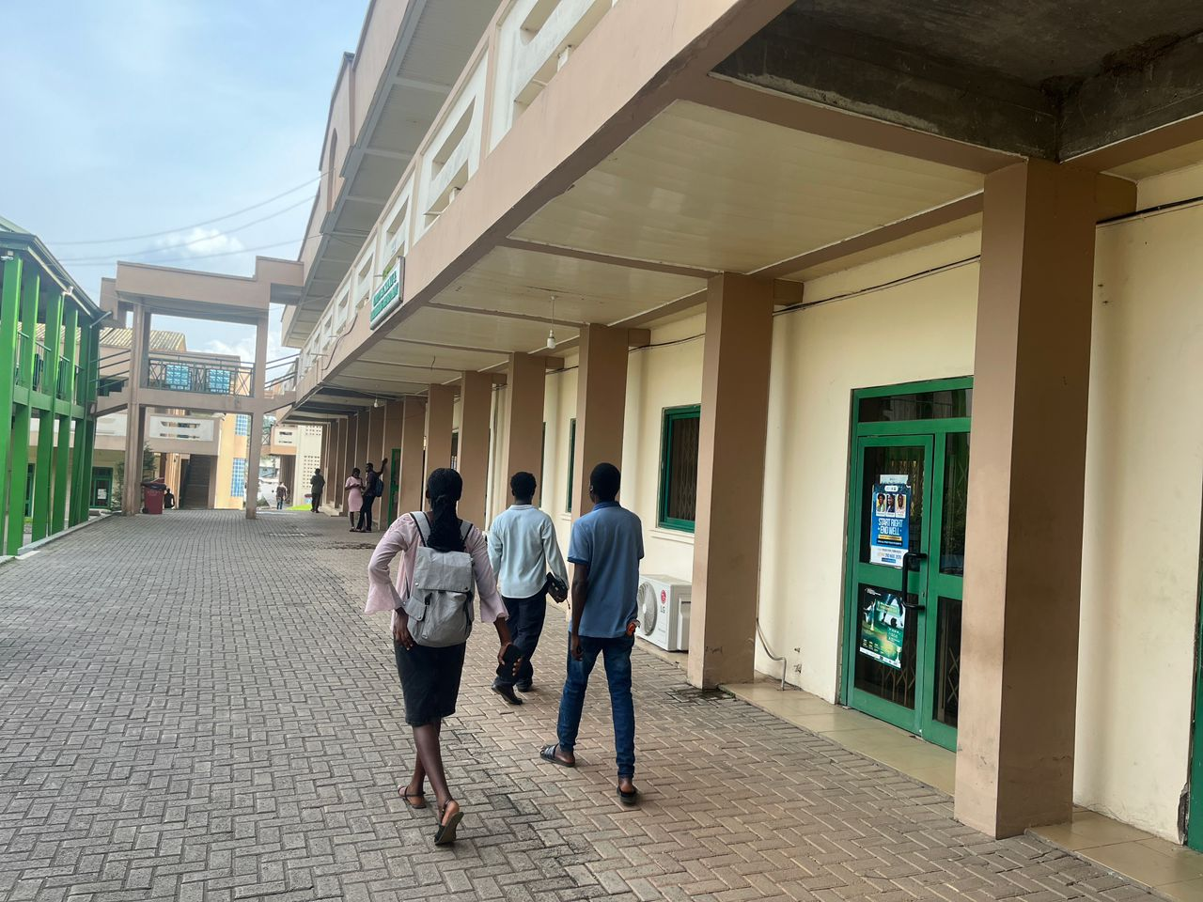

HUMAN & OPERATIONAL SECURITY; THREATS
Social Engineering Threat Scenarios
HIGH
Tailgating / Piggybacking
Attacker follows staff through a corner door without credentials. Four corner doors on CL1 and the Lab create multiple simultaneous entry vectors. Leaves no record.
HIGH
Unattended Workstation Exploitation
Students routinely leave computers logged in. An attacker can access files, install keyloggers, or extract credentials within minutes. No auto-lock policy enforced.
CRITICAL
Rogue Wireless Access Point
Attacker deploys personal hotspot inside the building cloning a departmental SSID. Given open networks already exist, users have no reliable cue they connected to a rogue AP.
HIGH
Impersonation of IT / Maintenance
With no visitor registration or ID verification, a person posing as a technician gains unchallenged physical access to any area, including the server room.
Actual building corridor; tailgating scenario
Enterprise & Perimeter Security Analysis | UMaT ACSES Department

Slide 17


NETWORK ARCHITECTURE; TOPOLOGY
Defence-in-Depth Network Architecture
INTERNET / CAMPUS BACKBONE
DEFENCE-IN-DEPTH LAYERS
01
Perimeter
Firewall + IDS filters all campus traffic
FIREWALL / IDS (Snort)
02
Segmentation
WIPS Monitor
CORE L3 SWITCH + ACLs
5-VLAN design + per-VLAN ACL enforcement
RADIUS / SIEM
03
Authentication
VLAN 10
VLAN 100
VLAN 200
VLAN 300
VLAN 400+
802.1X / RADIUS + NAC posture checks
Mgmt
Restricted
Controlled
Public
Guest/Quar.
04
Monitoring
WIPS + SIEM + NMS continuous visibility
Enterprise & Perimeter Security Analysis | UMaT ACSES Department

Slide 18
NETWORK ARCHITECTURE; VLAN DESIGN
5-VLAN Segmentation Design (Expanded from 3)
Design principle: Deny all inter-VLAN traffic by default; permit only explicitly justified flows by exception
VLAN 10
Switches, APs, wireless controller, RADIUS, SIEM
No user devices permitted. IT admin workstations via explicit ACE only. All other inter-VLAN traffic denied.
MANAGEMENT
VLAN 100
Server room, core infrastructure, IT admin workstations
Internet via firewall only. Deny all inbound from VLAN 200/300/400/500. Permit RADIUS queries from VLAN 200.
RESTRICTED
VLAN 200
Lecturer offices, IT support, authenticated staff lab workstations
Internet access permitted. TCP 445/443 to VLAN 100 (file server). Deny inbound from VLAN 300/400/500.
CONTROLLED
VLAN 300
Student classroom PCs, captive-portal authenticated student devices
Internet only (TCP 80/443/DNS). Client isolation enabled. Deny all RFC1918 destinations.
PUBLIC
VLAN 400
Visitor & contractor devices, time-limited sponsor-approved access
Internet only. 5 Mbps cap. Session time limit. Deny all RFC1918. Complete isolation.
GUEST
VLAN 500
Devices failing NAC posture checks, unrecognised MAC addresses
Update/patch servers only. No internet. No internal VLAN access. DHCP by NAC.
QUARANTINE
Enterprise & Perimeter Security Analysis | UMaT ACSES Department

Slide 19
NETWORK ARCHITECTURE; ACL & RADIUS
ACL Implementation & RADIUS Authentication Flow
SAMPLE ACL; VLAN 200 (CONTROLLED ZONE)
802.1X / RADIUS AUTHENTICATION FLOW
ip access-list extended VLAN200_OUT
1
Device associates with staff SSID (WPA3-Enterprise)
remark Allow SMB to file server (VLAN 100)
permit tcp 10.200.0.0 0.0.255.255
2
Wireless controller initiates EAP exchange (PEAP-MSCHAPv2)
10.100.0.0 0.0.255.255 eq 445
remark Allow HTTPS to file server
permit tcp 10.200.0.0 0.0.255.255
3
RADIUS server validates credentials against LDAP directory
10.100.0.0 0.0.255.255 eq 443
remark Allow internet-bound traffic
permit ip 10.200.0.0 0.0.255.255 any
4
Success → RADIUS returns Tunnel-Private-Group-ID (VLAN 200)
remark Block all other internal traffic
deny ip 10.200.0.0 0.0.255.255
10.0.0.0 0.255.255.255
5
Failure → RADIUS returns Access-Reject → device denied entirely
Equivalent ACLs defined for all 5 VLAN SVIs and validated in Cisco Packet Tracer before GNS3 full-topology test.
6
NAC posture check: OS patch level, AV active, firewall on
7
Posture fail → NAC overrides VLAN to 500 (Quarantine)
8
All auth events (success/fail/timeout) forwarded to SIEM
Enterprise & Perimeter Security Analysis | UMaT ACSES Department

Slide 20

Conclusion
This analysis has assessed the ACSES Department building across five critical security domains. The department currently operates with zero formal security infrastructure; no access control, no surveillance, no wireless protection, and no procedural safeguards.
The layered strategy proposed here; from emergency lighting and WPA3 to 802.1X/RADIUS, NAC, WIPS, and SIEM; forms a coherent, proportionate, and implementable response. Each layer is grounded in real-world tooling (FreeRADIUS, PacketFence, Kismet, Wazuh) and validated in GNS3 / Cisco Packet Tracer before physical deployment.
Key
Takeaways
No formal security controls of any kind exist today
Lighting failure blocks CCTV; must be fixed first
IMMEDIATE ACTION PRIORITIES
Priority 1; Restore all building lighting (ground floor: 1/18 functional)
3 open Wi-Fi networks; signal at −62 dBm in car park
Priority 2; Decommission open networks; enforce WPA3 across all APs
5-VLAN + 802.1X + NAC + WIPS = real-world hardening
Priority 3; Deploy CCTV, keycard access, and visitor registration
Phased delivery: WPA3 now → controller → NAC/SIEM
Priority 4; RADIUS, NAC, WIPS, SIEM; full wireless & network hardening
CONFIDENTIAL; FOR ACADEMIC USE ONLY | UMaT Enterprise Security Analysis

